Slide 1
Visualizing 10 Years (2005-2015) of Life in Hampton Roads
Prasanna Sajjan
CS 698 – Master’s Project
Advisor: Dr. Michele C. Weigle
Department of Computer Science, Old Dominion University

Slide 2
Motivation
The idea was originally proposed in CS 725 class (Spring 2015), by James Clary, Senior Economist at Hampton Roads District Planning Commission (HRPDC)
Folks at HRPDC wanted to see trends in income and employment data spread across different industries and occupations. They also wanted to know about the graduation rates and commuting patterns
They wanted to use the results from this project and then compare it with the overall average of U.S, to see where things need to be improved
Curiosity to know about the area I have lived in for the past 2 years and passionate about dealing with large data sets and converting them into meaningful visualizations

Slide 3
Domain Specific Questions
How has income and employment changed over time for different industries and occupations?
Which locality had the highest graduation rate and how has it changed over time for each locality?
How many people commuted to work in each region and where did they commute to for work?

Slide 4
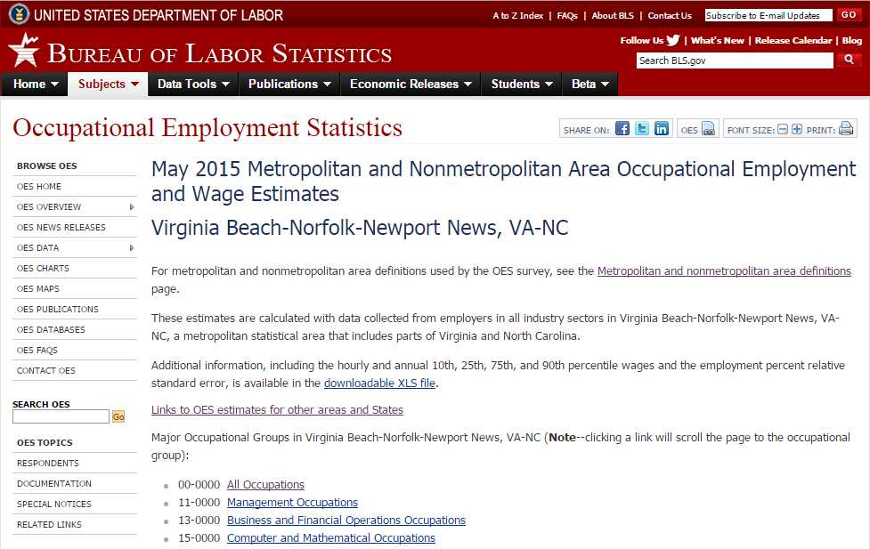
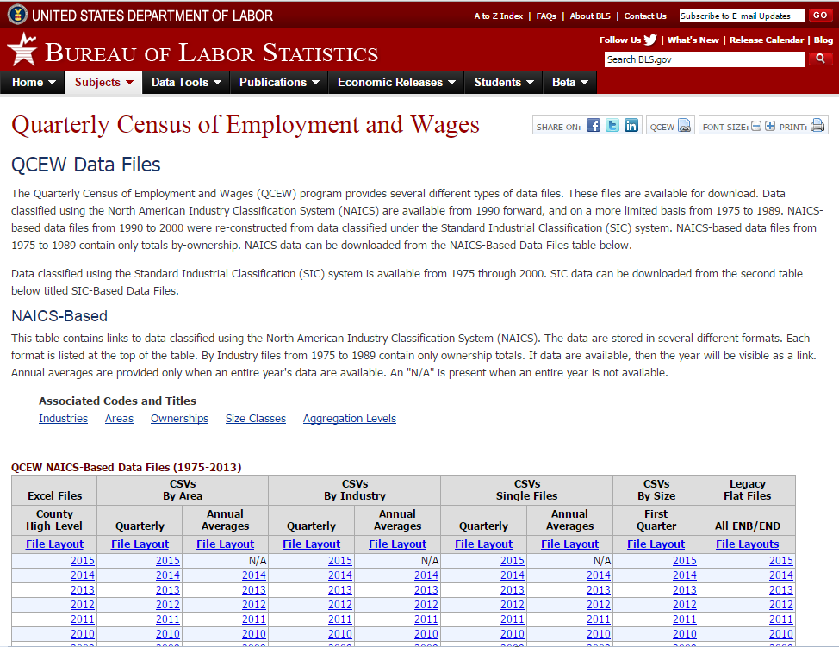
Data Source
Quarterly Census of Employment and Wages (Bureau of Labor Statistics) - http://www.bls.gov/cew/datatoc.htm
Occupational Employment Statistics (Bureau of Labor Statistics) - http://www.bls.gov/oes/current/oes_47260.htm

Slide 5
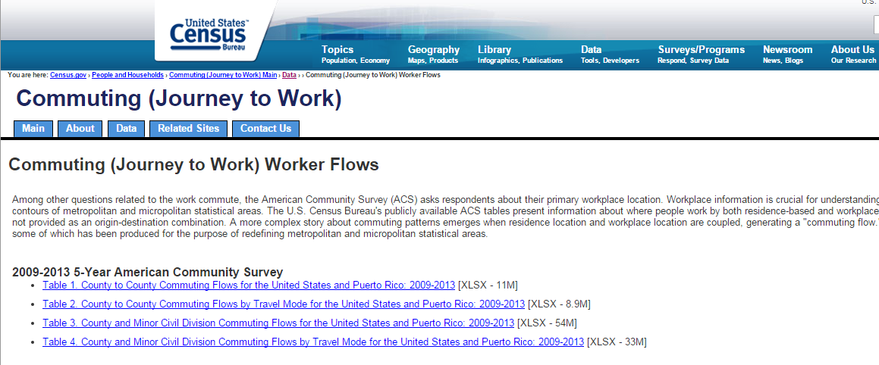

Slide 6

Data Source
American Community Survey and Decennial Census Journey to work data (U.S Census Bureau) - https://www.census.gov/hhes/commuting/data/commutingflows.html
Virginia Department of Education - http://www.doe.virginia.gov/statistics_reports/index.shtml

Slide 7
Data Set and Cleaning
All the data-sets were available in the form of Excel spreadsheets. Each spreadsheet had roughly 50,000 - 160,000 records
Initially, I tried to clean the data using Python and VB scripts, but data was inconsistent
Most of the cleaning was done manually, added custom headers and used data filters as per the requirement

Slide 8
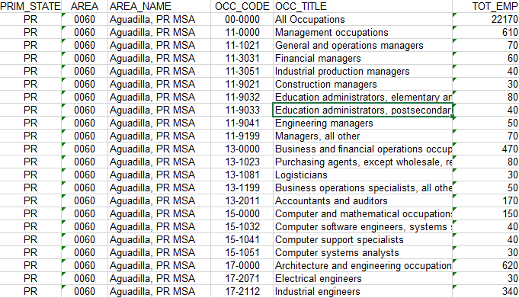
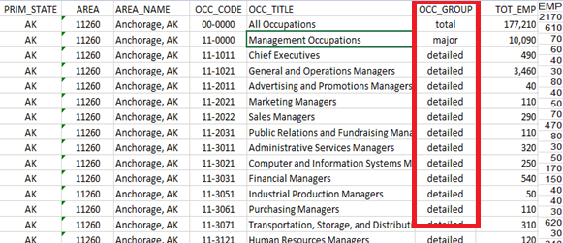
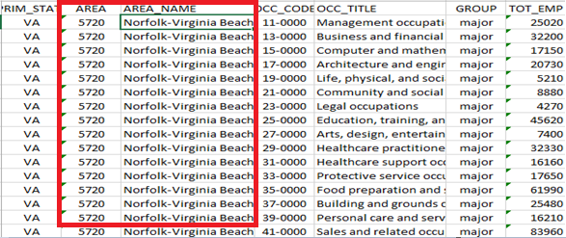
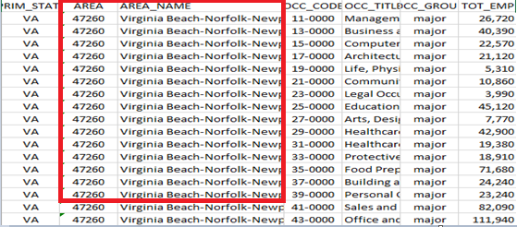
Data Inconsistency Snapshot of 2005 Snapshot of 2014

Slide 9
Description of the System
Income & Employment by Industry
Line charts to show change in & size of income and employment over time
Bar charts to measure these changes on a percentage scale
Tableau, MS Excel
Income & Employment by Occupation
Line charts to show change in & size of income and employment over time
Tableau, MS Excel

Slide 10
Description of the System
Graduation rates in Hampton Roads by Locality
Interactive line chart to examine changes in graduation rates by locality
Choropleth map and static line charts to study graduation rates based on gender, race and socio-economic factors
D3.js, JSON, HTML, CSS, jQuery and JS
Commuting Patterns in Hampton Roads
Choropleth map and tooltip to show the commuting patterns
Tableau, latlong.net, MS Excel
Finally, everything was put together using Bootstrap framework

Slide 11
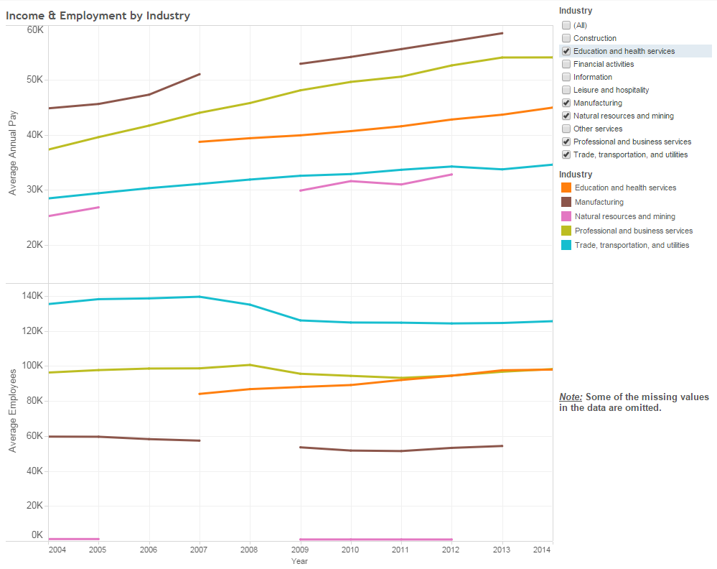
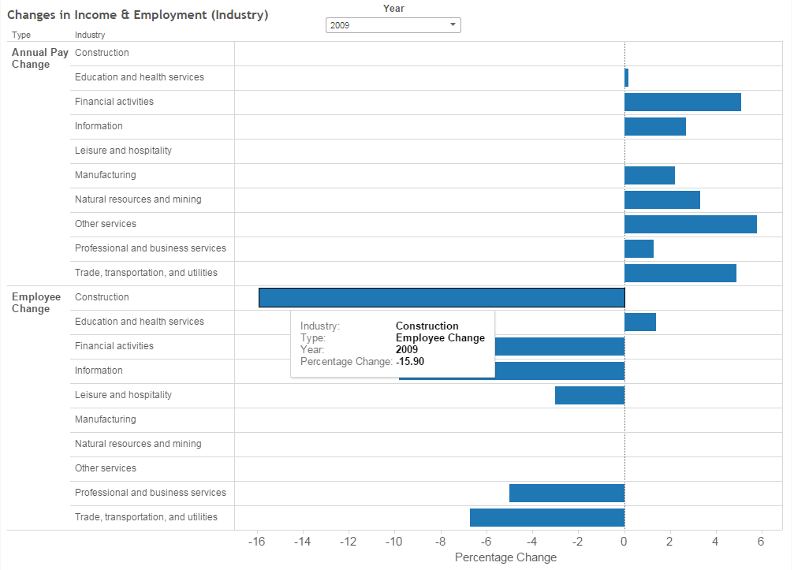
Insights - Income & Employment by Industry
After the “Great recession” (2007) in the U.S, all the industries experienced a decline in the number of employment but Education & health services saw a steady increase
Construction industry had the highest impact (16% decrease in employment)

Slide 12
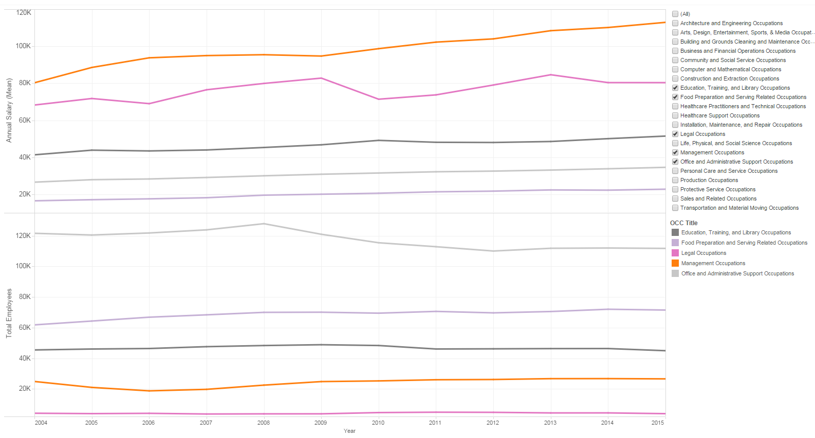
Insights - Income & Employment by Occupation
Management occupation paid the highest annual wages, whereas Food preparation & serving related occupation paid the least
The “Great recession” had no major impact on any of the occupations

Slide 13
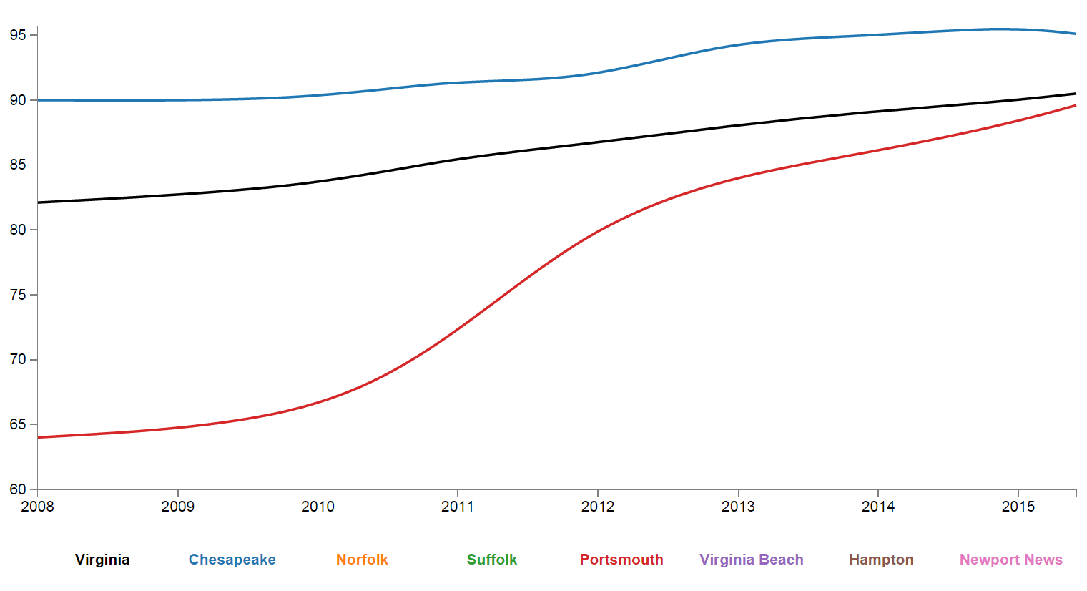
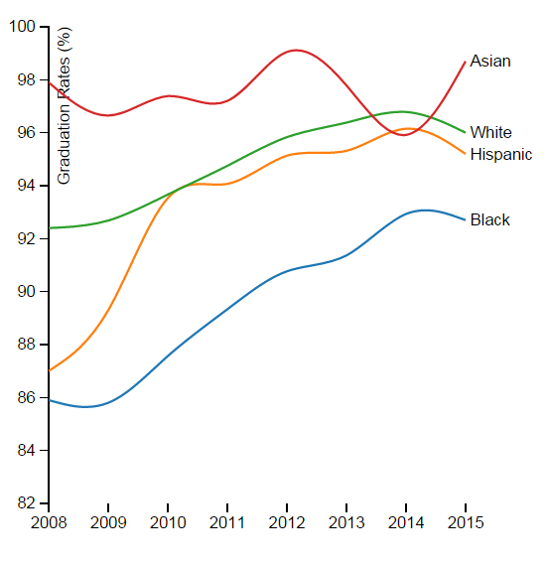
Insights - High school graduation rates
Chesapeake showed the highest graduation rates and Portsmouth showed the lowest graduation rates.
Female students dominated over male students in every city. White & Asian (minority) dominated other races in all the cities

Slide 14
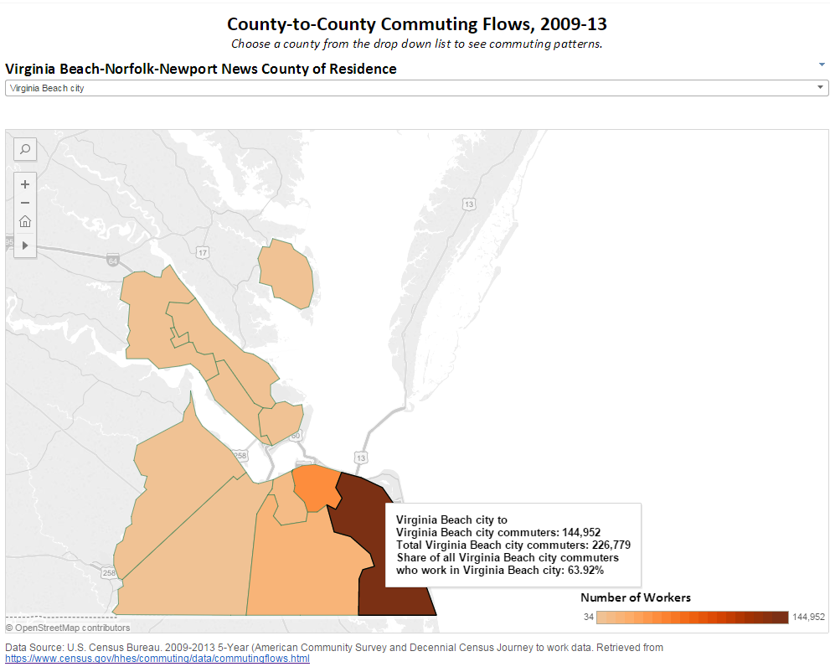
Insights - Commuting patterns
Virginia Beach city had the highest number of commuters, whereas Mathews county had the lowest
Norfolk city had the highest retention rate (67.63%) and York county had the lowest (27.89)

Slide 15
Challenges
Data was structured but not easy to read. (Column headings were named using standard conventions)
I had to manually find out the latitude and longitude for each locality and use that as a reference to draw the map in Tableau
It is very easy to get lost and confused on these government websites
We plan to get in touch with another contact at HRPDC and share this work with them

Slide 16
Future Work
Study can be expanded to other regions of the U.S since the data set is available for all the regions
For graduation rates, others factors can be considered to study the effect, such as cost of living, crime rate in the area
For commuting patterns, region outside Hampton Roads can be included in the map since some commuters travel outside HR area
URL to the project - http://www.cs.odu.edu/~psajjan/cs698/

